Slide 1
^{9th} Meeting of the S-100 Working Group
S-100 Validation Checks sub group report
Liz HAHESSY
Agenda Item 8_1

Slide 2
Agenda
Progress of sub group
Status of tasks
Structure of S-158:1xx documents
Handover of S-158:1xx to PS
Maintenance
Issues encountered
Future of format of S-100 Validation checks
Cross product validation

Slide 3
S-100 validation checks sub group meetings
4 VTCs since S-100 WG8
Feb 2024
April 2024
September 2024
October 2024
2 contracts have been issued:
Production of PS validation checks documents (checks & cover document) and formatting to standardised template (NOAA - July)
Production of S-100 validation checks documents (checks & cover document) and cross product validation (IC-ENC - October)
https://iho.int/en/s-100-validation-sub-group
iho-ohi/S-100-Validation-Checks: S-100 Github repository for Validation Check development.

Slide 4
deliverables
Naming convention of validation checks
Standardised template
Agreed S-158:1xx format for PS validation checks
Removed from inside PS
S-100 validation checks
S-98 / Cross Product validation checks tests for use on ECDIS

Slide 5
S-100 validation checks refresher
The checks are focused on datasets that will be used on an ECDIS for Phase 1 (Route monitoring)
For a check to exist it has be related to a clause or table in supporting S-1xx or S-98 document.
Trying to not repeat lessons from S-58 where we have some checks that are not directly linked in the standards
If we cannot stick to this may need to be flexible
Producing initial list that can be expanded upon

Slide 6
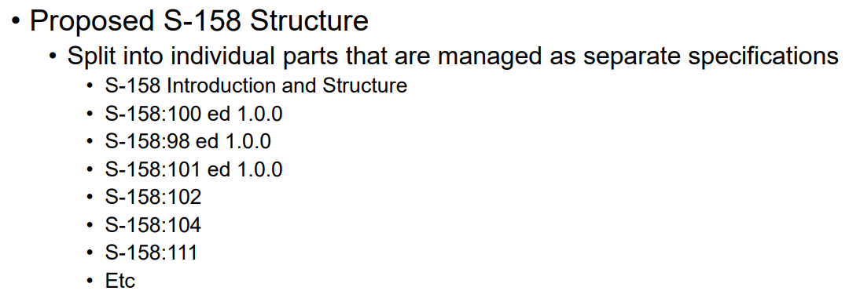
Hssc – items relevant to S-100 validation
Approved the use of S-158 & agreed structure
Validation checks against S-100 itself
S-98 Validation (including cross product)
Validation checks for individual S-100
Product Specifications
These will be managed by individual HSSC WGs/PTs (development, submission, endorsement and approval)
High risk of not meeting the deadline
S-100 Validation has joined the ISO Cell group to track progress as there are concerns regarding completion.
S-158:100 & S-158: 98 will be submitted to HSSC 17 2025

Slide 7
Standardisation of validation checks
At S-100WG8 Val sub group was tasked with producing standardised format for validation checks and naming convention
Naming convention (agreed at S-100 WG8)
Product Specification number at the front the check. e.g. S101_0001
Checks four digits long
Currently only use numerical check IDs but will have the option to introduce a,b,c if needed later to split checks

Slide 8
Template structure
Dev ID | Check ID | Classification | Check Message | Check Description | Check Solution | Standards document reference | Clause reference | Data Quality Measure | Introduced | Modified | Deleted
Column | Meaning
Dev ID | Used during development, potentially kept for first edition at the request of validation software implementors
Classification | Critical Error, Error & Warning – will use C, E & W
Check Message | Shorter message informing what is wrong
Check Description | Longer message outlining problem
Check Solution | Suggested action to rectify issue
Standards Document Reference | Source document/s for conformance
Clause Reference | Specific clause/s in previous listed document/s
Data Quality Measure | DQ Themes/Measure from DQWG
Introduced, Modified & Deleted | x.x.x of standard that action happened
Bespoke PS checks | Each PS can add own columns after template

Slide 9
Template feedback
Template was circulated to PS owners, RENCs and some implementers in August
Comments received:
Wish to keep Dev ID for first publication – for tracking
Is a superseded column needed – for S-101 can be used to map relationship to S-58? S-101 and other PS can add additional columns
Common structure for a change log
DQWG –
recommend switching DQ Measure & Classification
Recommend follow ordering in data quality evaluation
Logical consistency/Format consistency
Other Logical consistency (concept consistency, domain consistency and topological consistency)
Completeness (Commission and omission)
Accuracy (positional, thematic and temporal aspects)
Dev ID | Check ID | Classification | Check Message | Check Description | Check Solution | Standards document reference | Clause reference | Data Quality Measure | Introduced | Modified | Deleted

Slide 10
Dqwg comments
How align between groups?
Trying to cater to multiple users – implementers, data producers & DQWG structure
Separately another proposal was to remove the DQ Measures from the validation checks
Need to ensure we have sufficient resources to publish on time
ACTION: Ask the WG to approve the structure of the checks as in the draft template for the first operational version of Validation Checks

Slide 11
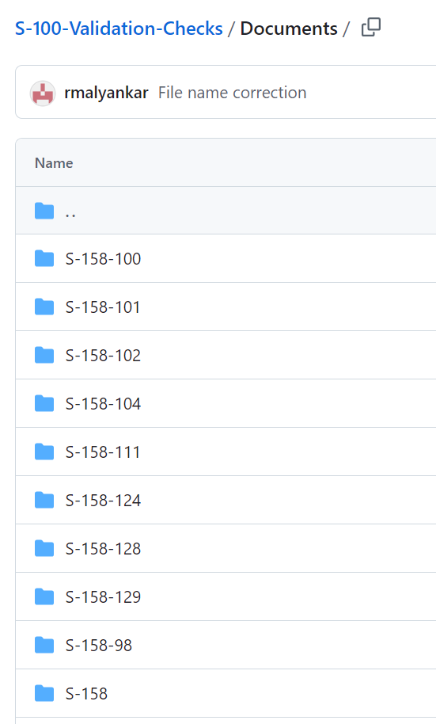
Progress of S-158:Sxxx for PS
Following documents are out for review:
S-158:101
S-158:102
S-158:104
S-158:111
S-158:124
S-158:129
Comprises of cover text document and spreadsheet of checks
Received feedback from S-101, S-102 and S-129

Slide 12
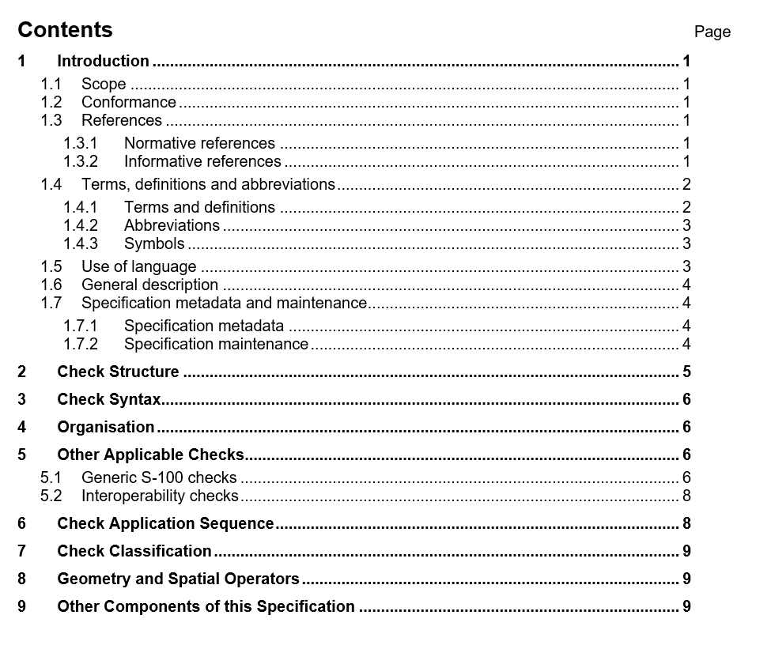
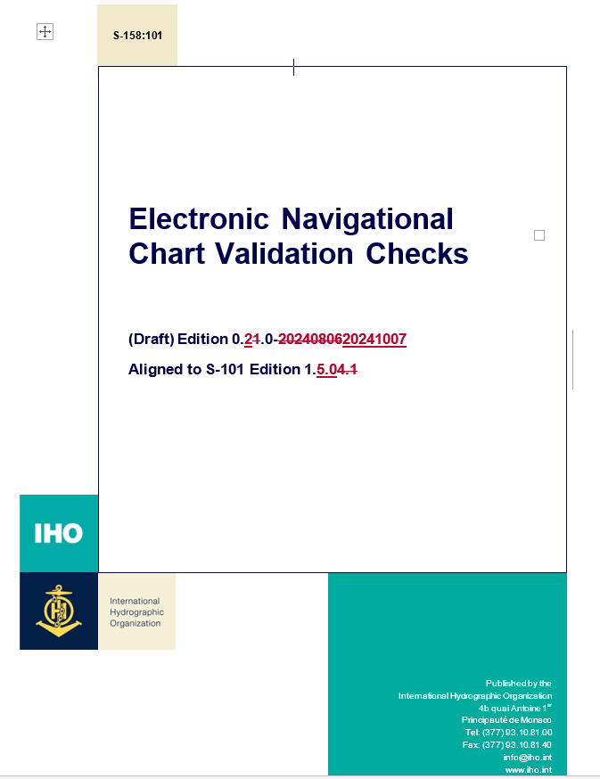
Structure of S-158:1xx
2 parts:
Cover document
Validation Checks

Slide 13
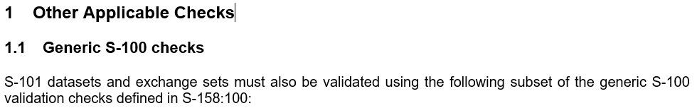
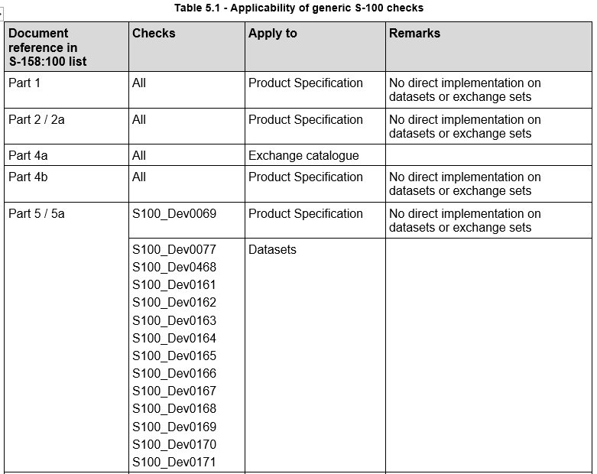
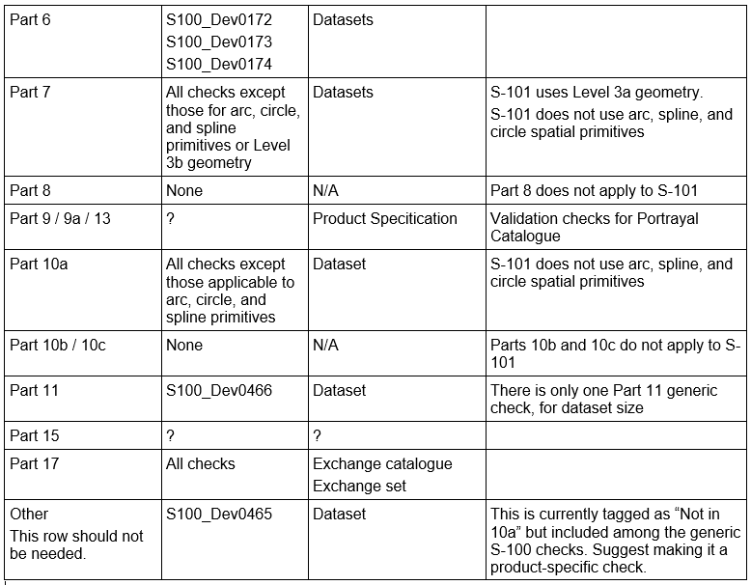
Applicability of generic S-100 checks to PS
Trying to link which S-100 validation checks/ Parts are relevant to different Product Specifications

Slide 14
Handover to Project teams
ACTION FOR PTs:
Once handed over the PTs take responsibility for development, submission, endorsement and approval
Get validation checks up to date for S-100 5.2.0 and their own latest PS version
Check for duplication with S-100 generic checks and remove if needed, may have to happen after first operational version
Upload the draft validation checks to the IHO Registry (via Jeff)
Be involved in Cross Product validation checks
ACTION: S-100 WG to approve that the S-158:1xx are handed over the PS teams and that they have the responsibility to maintain them and submit them to HSSC
If not approved now, need resources to maintain inside sub group

Slide 15
Publishing of S-158:1xx
Timing issue as PS Validation Checks are ready before S-158:100 operational edition is published
When do we publish?
S-101 keen to publish now to allow implementers to start working with them
How do we fast track the S-101 Validation Checks?

Slide 16
Maintenance of Validation checks
Need a maintenance procedure and how handle Managed Impact Study
Do we agree that we will keep them all in the same format?
e.g. cover document and checks in Word and Excel or is it acceptable for PS to differ?
Potential issue that we are handing standards back to PS before a maintenance regime has been established
Propose that sub group work on a maintenance procedure but will need support
ACTION: ask S-100 WG to support the development of a maintenance procedure and that PS keep documents in the supplied format
(will come back to format of checks later)

Slide 17
Progress of S-158:Sxxx for PS.
Contract has been awarded to Raphael Malyankar to produce the S-100 validation checks & cross product validation, cover documents
Funds for contract supplied by IC-ENC Special Activities fund
Need to establish how coordinate across the PS and WGs.
Currently 377 checks but not all parts have been reviewed
Draft ready December 2024
Final ready February 2025
Submission to HSSC 17
It is important that people review the checks when they are circulated

Slide 18
Issues - citations
Long standing issue of how to list multiple clauses in S-158
Circulated 2 options in September around PS owners, implementers and RENCs
Machine readable vs. human readable
Agreed on option 1, using box brackets to separate clause numbers for different documents
Note:
documents must be separated by semicolon+space
Box brackets in clause reference must be separated by semicolon+space
Clause references for the same document must be separated by comma+space
No use of "and" before the last clause reference (or document)
No box brackets if there is only one document cited
Standards document reference | Clause reference
PS; Annex B | [4.3.2.1.1]; [5.1.28, 6.1.2.7]
PS | 4.3.2.1.1
PS; Annex A | [10.1.3]; [2.4.2]
PS; Annex A | [10.1.3]; [2.4.2]
Part 10a | 10a-7.2.4.1, 10a-7.2.4.2.7, 10a-7.2.4.2.8

Slide 19
Issues - Language consistency
Can be difficult to identify if checks are duplicated in S-100 and PS as have been written in a different style.
Longer term work – Possibly will need to be a revision of language in the future and consistency across validation checks

Slide 20
Issues - Separating dataset and standards checks
Different types of validation checks
Checks against datasets
Checks against standards
Completed at different times and by different users
e.g. is the FC compliant to the Registry, is not a data producer check but likely IHO check
Options, in order of preference of the sub group:
different document, potentially annex in S-97 and possibly a check list for the IHO Secretariat
separate sections in S-158:100
tag to identify
Action: Ask the S-100 WG to approve that the dataset/standards checks can be separated and choose preferred option

Slide 21
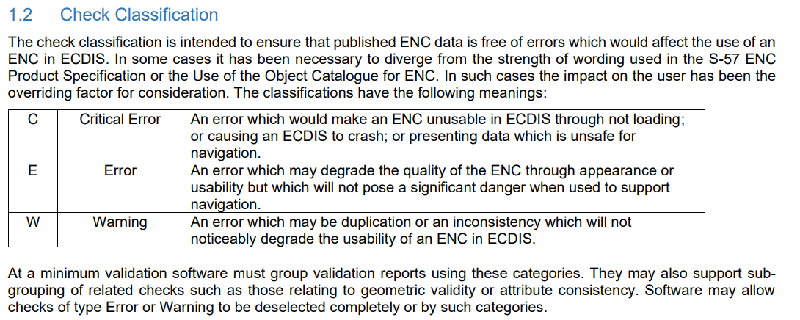
Issue - Classification of validation checks
Use of current S-58 Classifications – Critical Error, Error & Warning – ENC and ECDIS specific.
Will need rewording for S-100 - Jeff has offered to assist
Difficult to assess what is a ‘critical’ error for products that have not been used on an ECDIS previously
Longer term we will need to look at how we handle classification for non-navigational products
ACTION: S-100 WG to approve the continued use of Critical Error, Error and Warning for validation checks classification

Slide 22
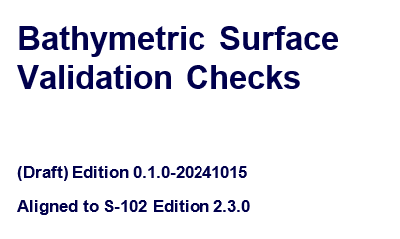
Issue - versioning
Versioning of PS components HSSC16/39
Propose that validation not tied to the PS version (FC, PC & IC)
Similar to how S-58 operates, validation checks at a much higher edition number than standard
IHO Resolution 2/2007
Must start at Edition 1.0.0 for operational version, so will not conform to TSM goal of keeping X.X in sequence with the PS
Other option is to review IHO Resolution 2/2007
What about the S-158:1xx PS validation checks
Do they want to keep that linked to the version of PS?
Action: Ask the S-100 WG to approve that S-158:100 operational edition is 1.0.0 and that the edition numbers are not tied to the PS going forward

Slide 23
Issue - Part 6 - Coordinate Reference Systems
Has not been updated for some years.
Is anyone using it?
There is no S-100 schema for Part 6. Examples in Appendix 6-A may be from ISO 191xx standards.
Do we need validation checks for Part 6 for Operational Version?
ACTION: Ask S-100 WG to approve the removal of Part 6 checks from operational version of S-158:100

Slide 24
Issue – resources
Usual issues with available resources
Work is being progressed now due to contracts
Received support from Denmark, Frank Hippmann and Primar in drafting parts of S-100 validation checks
It is important that the validation checks are reviewed
Limited number of people currently providing feedback

Slide 25
What format are the validation checks held in
The Excel format is working for now, but we all recongise this will not work longer term
Suggestions for a new Registry, a database, Metanorma, xml format
Different use cases
The documents cross multiple working groups, will there be an agreed format for all or can it differ?
Additional functionality requested
Link to valid versions of PS and S-100
Reuse of validation checks for other Product Specifications, but potential maintenance issues
Inland ENCs and AMLs may want to replicate some of the S-101 checks
Different formats of validation checks for machine/human readability
Being able to state which PS each S-100 check is valid against

Slide 26
Cont.
Proposal:
Longer term action to establish a Validation Checks Register inside the IHO Registry and coordinate with the ICE-PT on how to proceed
Operational release will be in Excel format.
ACTION: S-100 WG to support the initial delivery of operational version checks and investigation into potentially establishing a Register for longer term use

Slide 27
Format of cover documents
Currently in Word document format, currently will be operational version format
Could potentially look at Metanorma
Issue that can only publish one document per GitHub repository, so not certain how can manage this
If change to Metanorma before handover, will need resource support
ACTION: S-100 WG to support the initial delivery of operational version cover documents in Word format or provide support to convert to Metanorma

Slide 28
Cross product validation
Restrictions may be needed for WLA
Likely these will need to be handled through validation checks
Refinement will likely be needed e.g. alignment of display scales, datums across products, gaps in data
Initial draft of S-98 checks created (46 checks). Based on the checks IIC previously produced and there were comments from 102 and 104 that need to be resolved
Need to coordinate across Working Groups & PTs
Arranging VTC to look at Water Level Adjustment (S-101, S-102 and S-104) 9th December
Likely hold another VTC in January to look into S-129 cross product validation

Slide 29
Next steps
Continue producing S-100 and S-98 validation checks
Drafts December
Final February
Submission to HSSC 17
Handover S-158:1xx checks to PTs
Arrange VTCs on Cross Product Validation
Work on a maintenance procedure

Slide 30
Action requested of S-100 WG
The S-100 WG is invited to:
a. Note the content of the paper.
b. Ask the WG to approve the structure of the checks as in the draft template for the first operational version of Validation Checks
c. S-100 WG to approve that the S-158:1xx are handed over the PS teams and that they have the responsibility to maintain them and submit them to HSSC
If not approved now, need resources to maintain inside sub group
d. Ask S-100 WG to support the development of a maintenance procedure and that PS keep documents in the supplied format
e. Ask the S-100 WG to approve that the dataset/standards checks can be separated and choose preferred option

Slide 31
Action requested of S-100 WG CONT.
f. S-100 WG to approve the continued use of Critical Error, Error and Warning for validation checks classification
g. Ask the S-100 WG to approve that S-158:100 operational edition is 1.0.0 and that the edition numbers are not tied to the PS going forward
h. Ask S-100 WG to approve the removal of Part 6 checks from operational version of S-158:100
i. S-100 WG to support the initial delivery of operational version checks and investigation into potentially establishing a Register for longer term use
j. S-100 WG to support the initial delivery of operational version cover documents in Word format or provide support to convert to Metanorma

